Slide 1
Data Tools Final Project
Data Tools Final Project
Adam Richman
Sarah Buckingham
Ava Guy

Slide 2
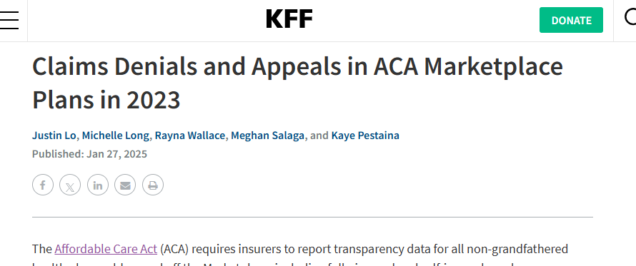
Health Insurance Claims
Our datasets come from KFF, the leading health policy organization in the U.S.

Slide 3
Table of Contents.
Problem Statement
Data Description
EDA/Visualizations
Result Interpretation
01
02
What are we hoping to learn? What is the application of our project?
What is our dataset? What metadata do we have to give context to our research?
03
04
Data cleansing, feature engineering; plots and graphs; key insights.
What are our takeaways from our analysis?

Slide 4
Problem Statement
01
What is the scope of our project? What research questions are we interested in?

Slide 5
Problem Statement
We would like to investigate health insurance trends, specifically as they relate to claim applications and denials of coverage, across different states, insurers, and years. Do certain providers deny more claims? Do certain years or states see higher denial rates?
We would like to use our analyses to paint a picture of the state of healthcare insurance claims, and their denials, in the United States. This holds incredibly real-world relevance due to the universality of Americans needing healthcare and the impact health insurance has on their ability to afford and obtain it.

Slide 6
Data Description
02
What datasets do we have available? What does the metadata tell us about our dataset?

Slide 7
Feature Engineering and Normalization
The dataset contains noise due to missing values and high variability in key attributes like claims received and denied.
Not all variables exist for all years of the distinct datasets, and not all values have comparable ranges.
We need to apply data imputation and normalization to ensure meaningful insights.
We can use feature engineering to create the following variables:
Denial Rate: claims denied/claims received
Claim Appeal Rate: % of appeals relative to number of total claims
Appeal Overturn Rate: % of appeals overturned relative to total number of claims
Time-based Features: Extracting years from data for trend analysis (2015-2023, one dataset/year)

Slide 8
Attributes & our “Data Dictionary”
There are 38 total unique attributes across the 2015-2023 datasets. Only years 2015-2019 include a “Data Dictionary” with metadata describing the attributes. Some of our attributes include:
Denial rate: Calculated as Claims denials/ Claims received
External Appeals Rate: Calculated as external appeals filed/ internal appeals upheld
Internal Appeals Rate: Calculated as internal appeals filed/ claims denials
We are going to focus on claims, denials, appeals, states, insurers, and our engineered features like the year and other rates to narrow the focus of our analysis.

Slide 9
Additional context: KFF Survey Data
We can look at the pdf on KFF to look at relevant polling statistics related to our investigation from their June 2023 publication.
This information was not included in the annual KFF Insurance Claims dataset, but adds context regarding how Americans perceive the process for applying for an insurance claim.
Notes:
This KFF Survey of Consumer Experiences with Health Insurance was designed and analyzed by public opinion researchers at KFF. The survey was designed to reach a representative sample of insured adults in the U.S.
The survey was conducted February 21 – March 14, 2023, online and by telephone among a nationally representative sample of 3,605 U.S. adults who have employer sponsored insurance plans (978), Medicaid (815), Medicare (885), Marketplace plans (880), or a Military plan (47). The sample includes 2,595 insured adults reached through the SSRS Opinion Panel either online or over the phone (n=75 in Spanish)

Slide 10
A majority of participants felt as if dealing with health insurance was as stressful as doing their taxes.
- KFF Survey

Slide 11
KFF Survey Data
Other facts and figures we extracted from the pdf of KFF’s “Survey of Consumer Experiences with Health Insurance” that are relevant to our analysis:
17% of participants were unable to receive medical care or treatment recommended by a medical provider as a direct result of the problems you had with your current health insurance.
15% of participants experienced a decline in your health as a direct result of the problems you had with your health insurance.

Slide 12
EDA and Data Visualizations
03
What does our analysis show us? What trends emerge from our datasets?

Slide 13
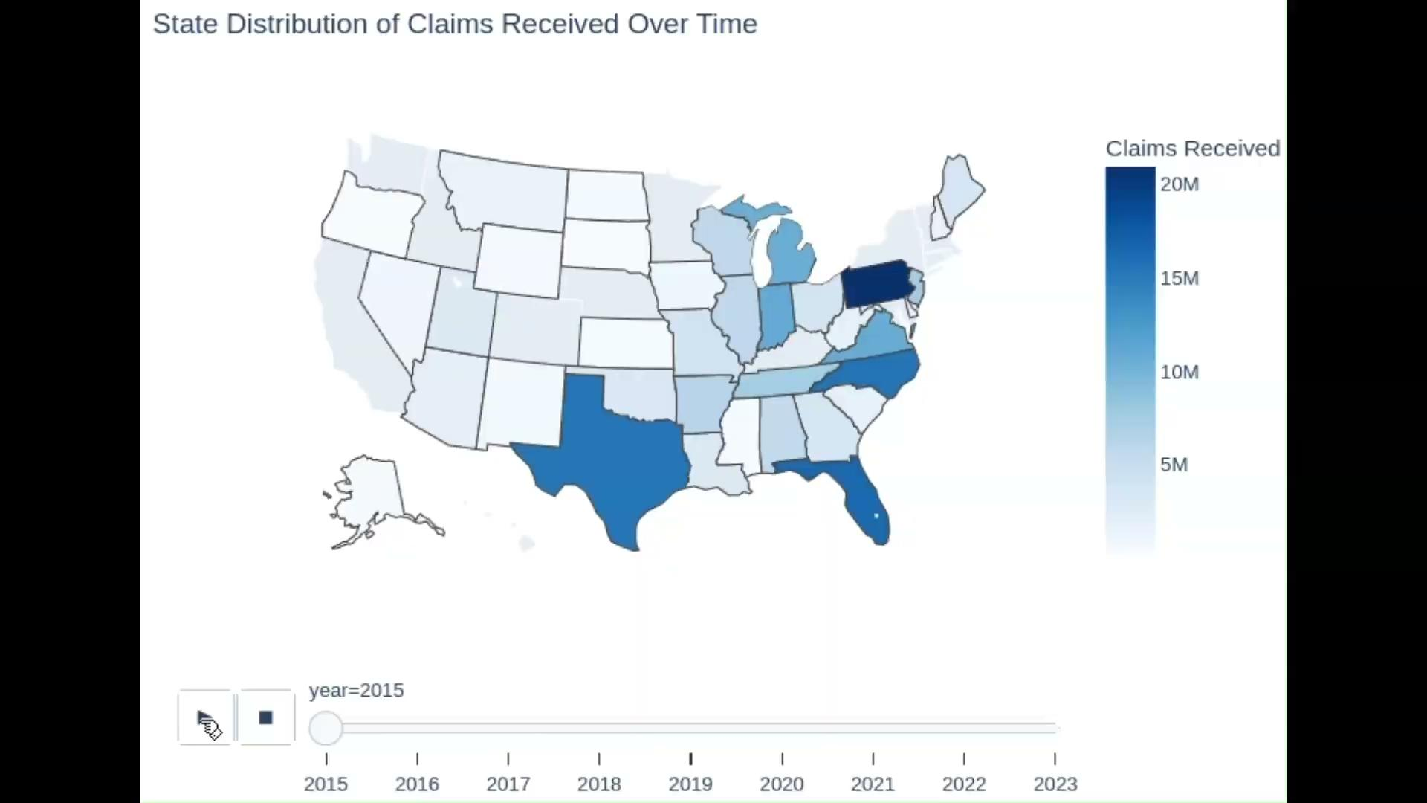
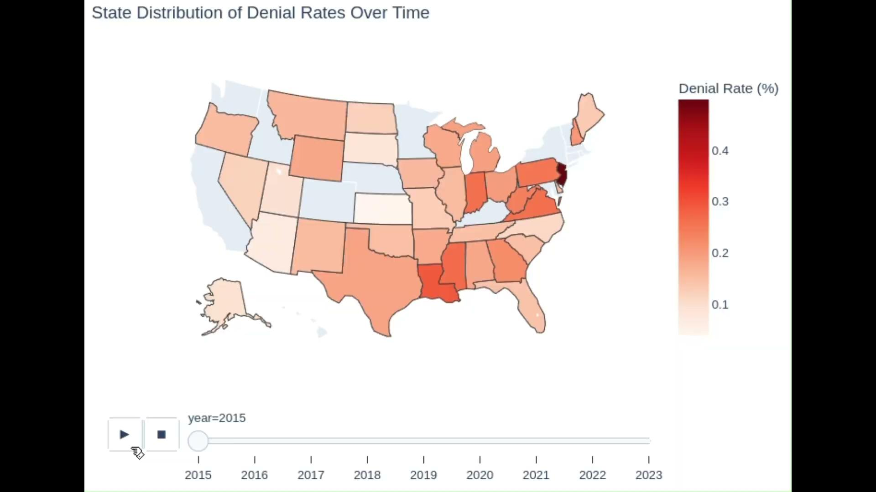
State Distributions of Claims
Range
Range
Min - 1.46m (ID) (13th least populous state)
Max - 509.21m (FL) (3rd most populous state)
Min - 8.1% (SD)
Max - 29.4% (NJ)
Min and max of states reporting included - please note that not all states reported data each year, some did not report at all.

Slide 14
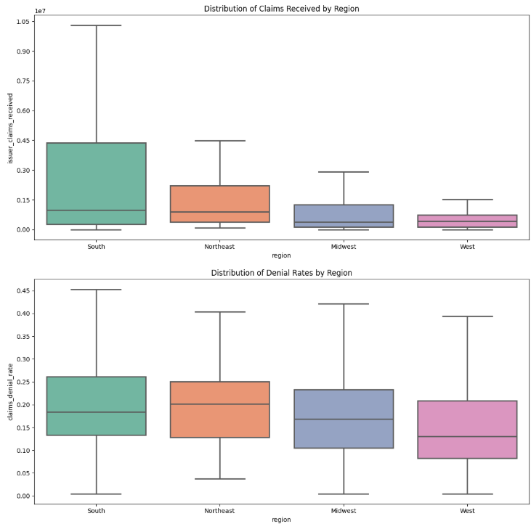
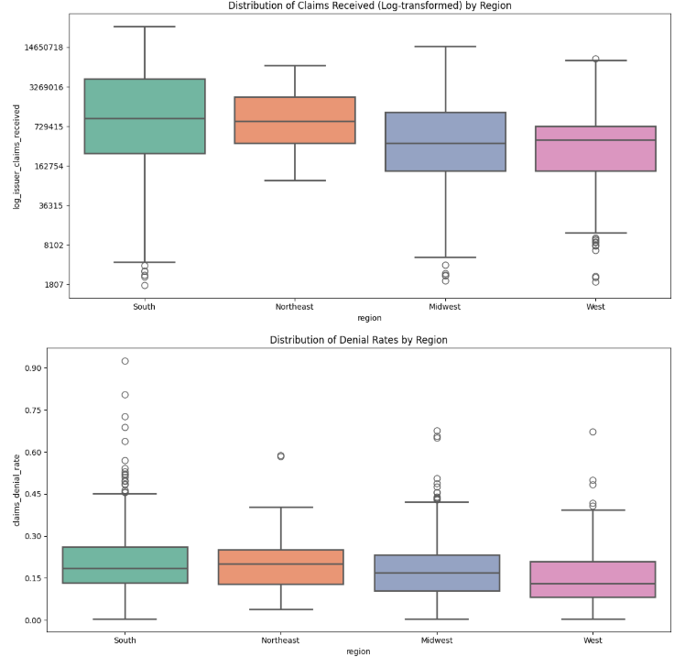
Regional Distribution
There appears to be a trend for Southern IQR to be higher.
The average issuer in the south has more claims & higher denial rates in the south.
The range of denial rates appears to be consistent across the regions.
Notes:
Further statistical analysis should be done to confirm significance of difference(s) in data.

Slide 15
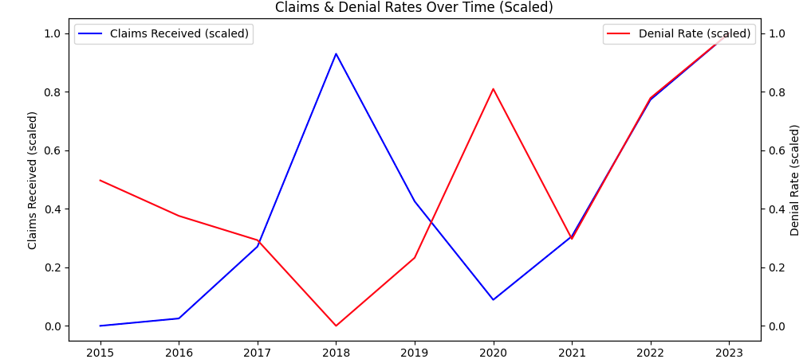
Time Series
This one is curious.
There appears to be an anomaly happening in 2018 and again in 2020, across the country, with respect to claim counts and denial rates.
The above data is scaled relative to each variable’s minimum and maximum values. The highest denial rate (prior to 2023) was in 2018 whereas the highest claim count was in 2020.

Slide 16
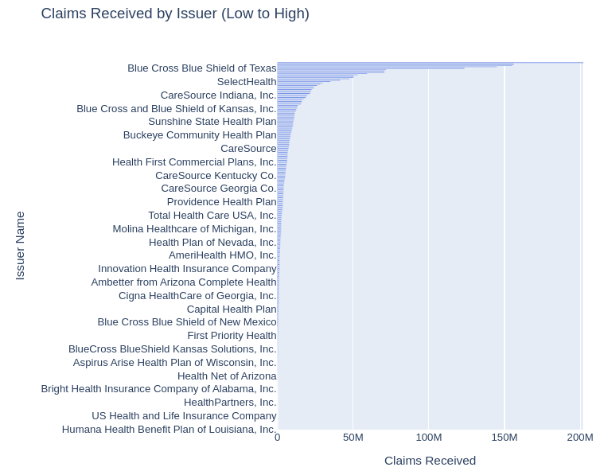
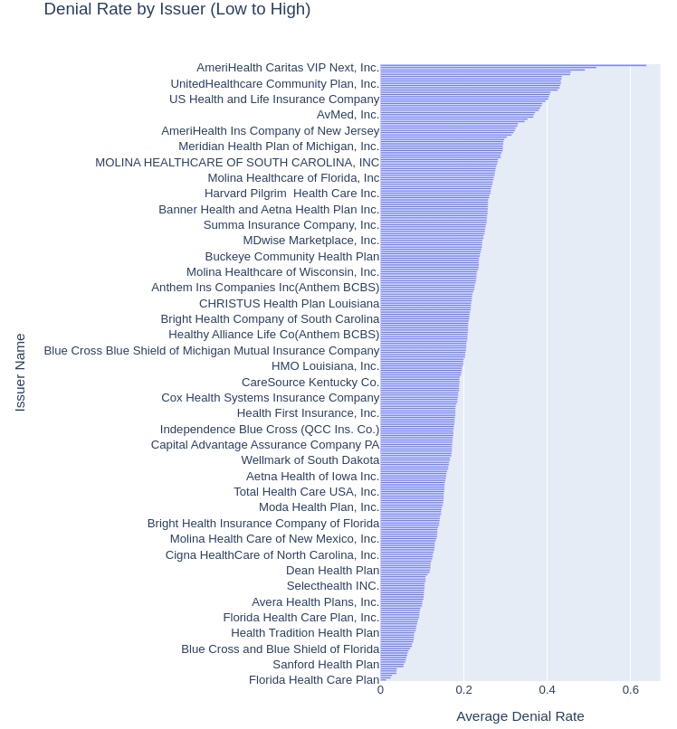
Variable Distributions by Issuer
Min - 1740 Max - 201.8m
Min - 1.37%
Max - 63.75%

Slide 17
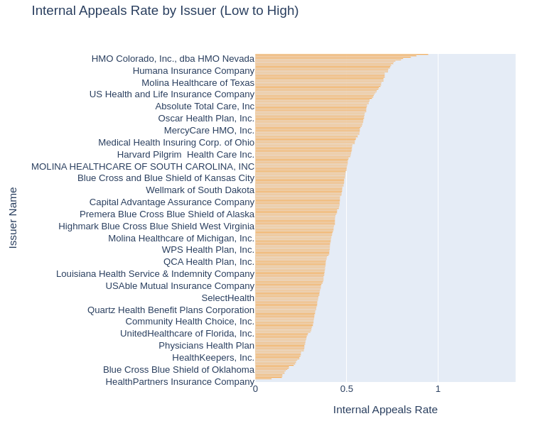
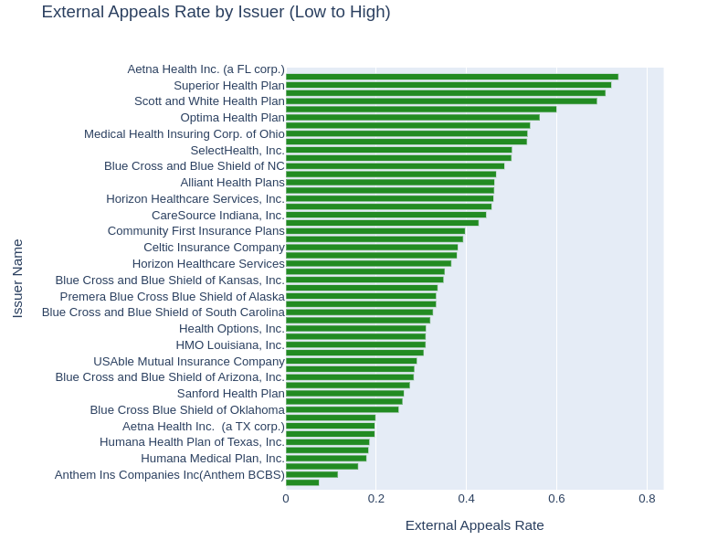
Variable Distributions by Issuer
Min - 8.9% Max - 94.7%
Min - 7.38% Max - 73.68%

Slide 18
Results
04
What are the takeaways from our analyses?

Slide 19
Key Insights
Region had a significant impact on denial rates.
Significant changes occurred in 2020.
Significant variability between issuers.
State policies contribute to denial rates with southern states having a higher denial rates and some states not publishing their data.
The 2020 global pandemic had significant impact on claim and denial rates with a large increase in claims and denials occurring from 2021 onward.
There is a large amount of variability between issuers when it comes to denials and appeals rates.

Slide 20
Summary: The Story of Health Insurance in the United States
There are significant variability for the likelihood of someone having an insurer with high denial rates or low appeal rates, depending on region, year, and issuer.
This can have profound impact on an individual’s ability to get the healthcare they need, making it a more stressful and difficult experience. This clearly can and does affect their health and well-being.

Slide 21
Thank you!
Any questions?

Slide 22
Credits.
Presentation Template: SlidesMania
Fonts used in this presentation: Antic Slab & Calistoga.
Data citation: Pollitz, Karen, et al. "KFF Survey of Consumer Experiences with Health Insurance." KFF, 15 June 2023, https://www.kff.org/affordable-care-act/poll-finding/kff-survey-of-consumer-experiences-with-health-insurance/.

